Slide 1

ENGLISH FINAL PROJECT
SPORT CULTURE
A Cross-Cultural Study of Individual and National Sports Identity
Final Presentation
Portal
Slide 1 / 10

Slide 2
STREET INTERVIEWS VIDEO
https://www.youtube.com/watch?v=LjGQXASJKd0
Final Presentation
Portal
Slide 2 / 11

Slide 3

BACKGROUND & SCOPE
THE STREET INTERVIEWS

Slide 4


CORE INTERVIEW STRUCTURE
CATEGORY A
CATEGORY B
Personal Routines
National Sports Culture
Understanding how individuals incorporate sports into their busy schedules, including their favorite sports, recent events they follow, and weekly exercise frequency.
Analyzing what makes a sport popular in the interviewee's home country. We explore infrastructure (like stadiums), funding, and local traditions that shape sports habits.
Focus: Personal Identity
Focus: Societal Impact
Methodology
Portal
Slide 4 / 11

Slide 5

CASE STUDY 1
UKRAINE & CZECHIA

Slide 6
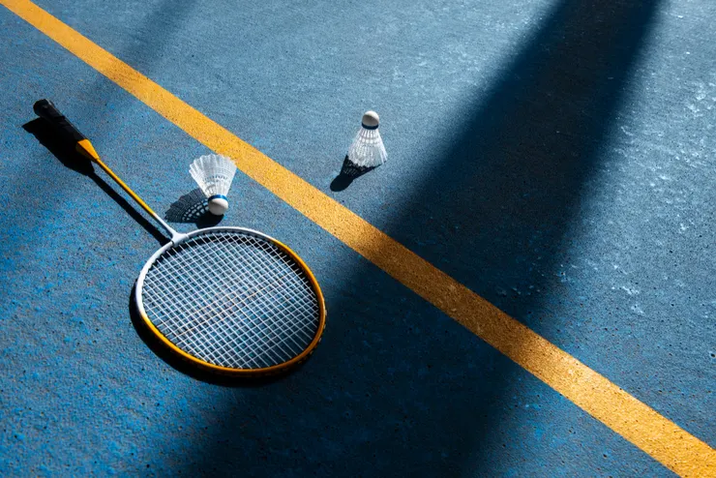

BADMINTON & CLIMBING CULTURE
A Ukrainian Perspective
The interviewee is an avid badminton player, playing 3 times a week, heavily influenced by Taiwanese friends who adore the sport.
Ukraine's National Sport: Football dominates national popularity and public interest.
Czechia's Climbing Trend: Climbing and bouldering (both indoor and natural rock walls) are exceptionally popular.
Individual vs. National: While his favorite is badminton, it is a niche sport in Ukraine.
Interviewee 1 Profile
Portal
Slide 6 / 11

Slide 7
CASE STUDY 2
GERMANY

Slide 8
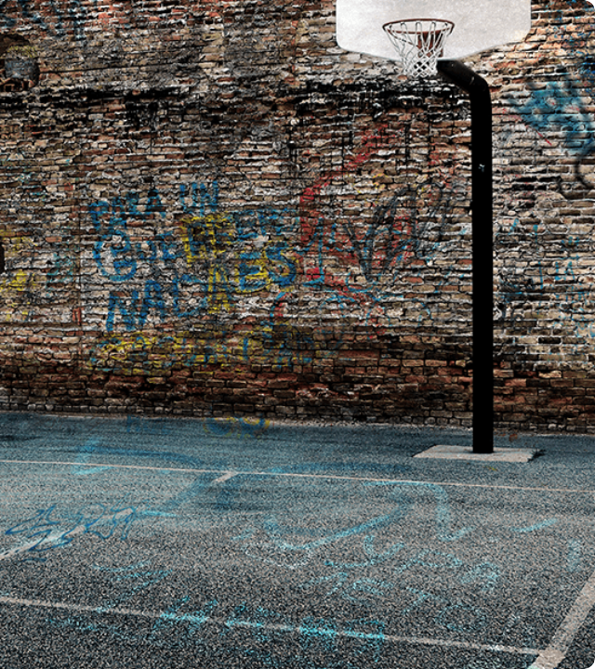
BASKETBALL & YOGA
The German Perspective
The interviewee is an office worker who uses yoga and "freeletics" in the morning and evening to maintain health and relieve posture stress.
Personal Pick: He prefers Basketball because it is "fast and dynamic," unlike football, which can be boring to watch for 90 minutes.
Football Hegemony: Every village in Germany has a football pitch, and it is where almost all sports funding goes.
Case Study 2 Portal Slide 8 / 11

Slide 9








KEY INTERCULTURAL TAKEAWAYS
Funding Rules
Dynamic vs. Static
Modern Wellness
In Europe, most financial resources and public infrastructure (fields, clubs) are heavily concentrated on Football.
There is a strong personal preference for fast-paced, high-action sports (like basketball) over traditional slow sports.
Yoga and functional bodyweight training are increasingly used as therapeutic habits to combat sedentary desk work.
Core Takeaways
Portal
Slide 9 / 11

Slide 10
THANK YOU
Presented by Portal Group
Portal
Slide 10 / 11

Slide 11

IMAGE SOURCES
Source: https://vocus.cc/article/683a92abfd897800013366ca
Source: www.starbackdrops.com
Portal
Slide 11 / 11

